Slide 1


Decentralized Finance, Transactional Data, and Survival Analysis
Aaron Green | March 28, 2023

Slide 2
What’s to Come
Decentralized Finance (DeFi) Introduction
Overview of Survival Analysis for DeFi questions
Overview of Transactional Data
Process of Creating Survival Data
Survey of insights gained using Survival Analysis

Slide 3
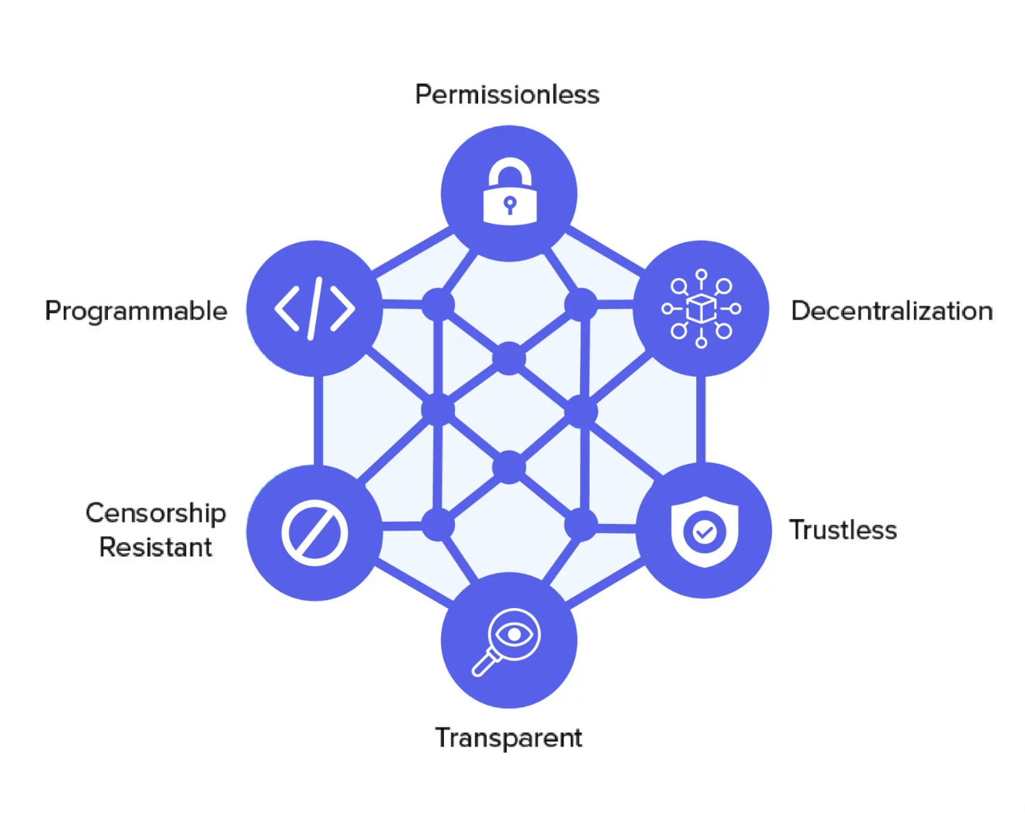
DeFi Introduction
Financial services built on blockchains
Platforms operate through smart contracts
No central intermediaries
Current DeFi Snapshot, including types of protocols and TVL

Slide 4
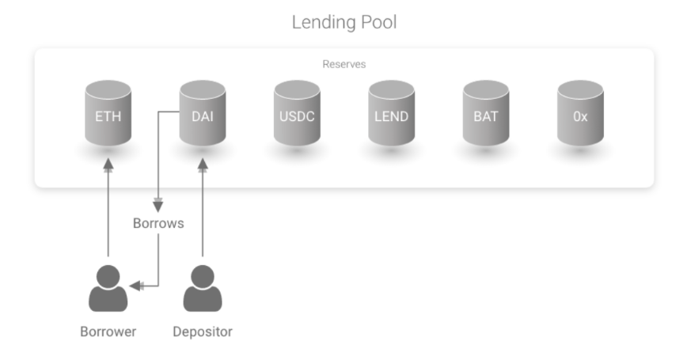
DeFi Lending Protocols
Savings Account:
Deposit various cryptocurrencies into account
Accrue interest on deposited funds
Smart-Contract Lending:
Borrow cryptocurrency supplied by others’ deposits
Use own deposits as collateral, at risk of liquidation
Source: https://github.com/aave/aave-protocol/blob/master/docs/Aave_Protocol_Whitepaper_v1_0.pdf

Slide 5
Survival Analysis For DeFi: An Introduction
Data-driven method for time-to-event analysis
Provides probabilities for occurrences of events through time
E.g. what is the probability that a user repays a loan in the first 100 days after borrowing money?

Slide 6
Survival Analysis For DeFi: An Introduction
Time (days) | Repaid?
78 | Yes
96 | No
52 | Yes
59 | No
39 | Yes
Data-driven method for time-to-event analysis
Provides probabilities for occurrences of events through time
E.g. what is the probability that a user repays a loan in the first 100 days after borrowing money?

Slide 7
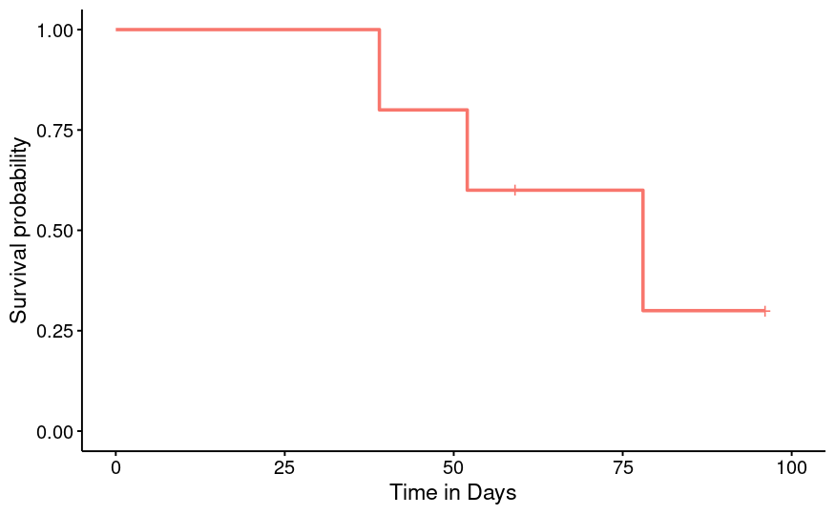
Survival Analysis For DeFi: An Introduction
Time (days) | Repaid?
78 | Yes
96 | No
52 | Yes
59 | No
39 | Yes
Data-driven method for time-to-event analysis
Provides probabilities for occurrences of events through time
E.g. what is the probability that a user repays a loan in the first 100 days after borrowing money?

Slide 8
Survival Analysis For DeFi: An Introduction
Time (days) | Repaid?
78 | Yes
96 | No
52 | Yes
59 | No
39 | Yes
11 | Yes
40 | No
77 | Yes
Data-driven method for time-to-event analysis
Provides probabilities for occurrences of events through time
E.g. what is the probability that a user repays a loan in the first 100 days after borrowing money?

Slide 9
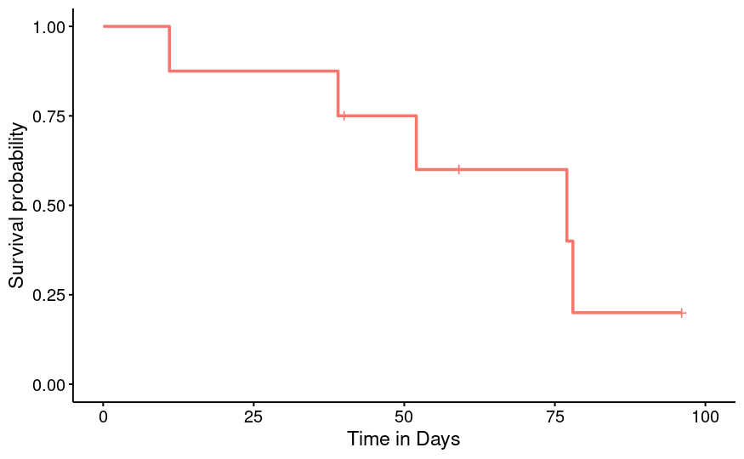
Survival Analysis For DeFi: An Introduction
Time (days) | Repaid?
78 | Yes
96 | No
52 | Yes
59 | No
39 | Yes
11 | Yes
40 | No
77 | Yes
Data-driven method for time-to-event analysis
Provides probabilities for occurrences of events through time
E.g. what is the probability that a user repays a loan in the first 100 days after borrowing money?

Slide 10
Survival Analysis For DeFi: An Introduction
Time (days) | Repaid?
78 | Yes
96 | No
52 | Yes
59 | No
39 | Yes
11 | Yes
40 | No
77 | Yes
Data-driven method for time-to-event analysis
Provides probabilities for occurrences of events through time
E.g. what is the probability that a user repays a loan in the first 100 days after borrowing money?
+ 92 rows (100 total)

Slide 11
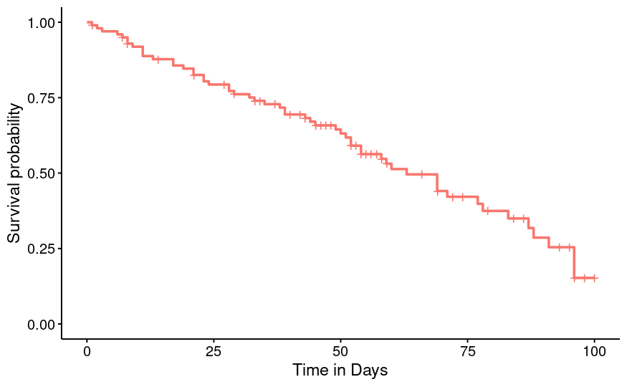
Survival Analysis For DeFi: An Introduction
Time (days) | Repaid?
78 | Yes
96 | No
52 | Yes
59 | No
39 | Yes
11 | Yes
40 | No
77 | Yes
Data-driven method for time-to-event analysis
Provides probabilities for occurrences of events through time
E.g. what is the probability that a user repays a loan in the first 100 days after borrowing money?
+ 92 rows (100 total)

Slide 12
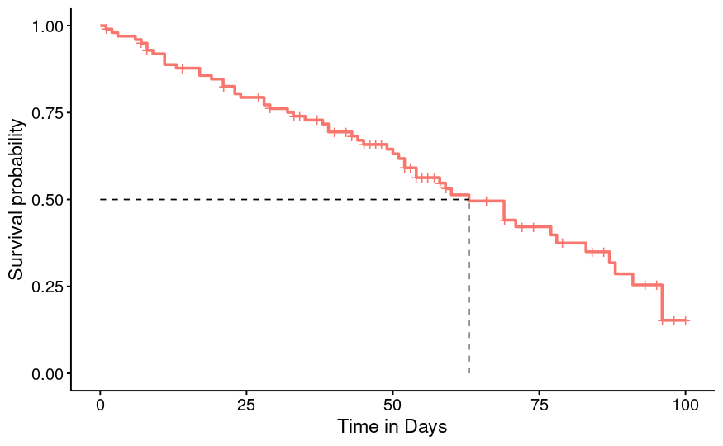
Survival Analysis For DeFi: An Introduction
Time (days) | Repaid?
78 | Yes
96 | No
52 | Yes
59 | No
39 | Yes
11 | Yes
40 | No
77 | Yes
Data-driven method for time-to-event analysis
Provides probabilities for occurrences of events through time
E.g. what is the probability that a user repays a loan in the first 100 days after borrowing money?
+ 92 rows (100 total)

Slide 13
Survival Analysis with Covariates
Time (days) | Repaid?
78 | Yes
96 | No
52 | Yes
59 | No
39 | Yes
11 | Yes
40 | No
77 | Yes
+ 92 rows (100 total)

Slide 14
Survival Analysis with Covariates
Time (days) | Repaid?
78 | Yes
96 | No
52 | Yes
59 | No
39 | Yes
11 | Yes
40 | No
77 | Yes
Coin Type
Stable
Non-Stable
Non-Stable
Stable
Stable
Stable
Stable
Non-Stable
+ 92 rows (100 total)

Slide 15
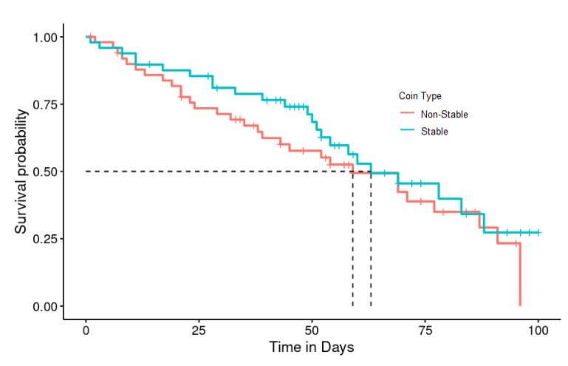
Survival Analysis with Covariates
Time (days) | Repaid?
78 | Yes
96 | No
52 | Yes
59 | No
39 | Yes
11 | Yes
40 | No
77 | Yes
Coin Type
Stable
Non-Stable
Non-Stable
Stable
Stable
Stable
Stable
Non-Stable
+ 92 rows (100 total)

Slide 16

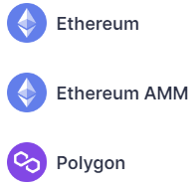
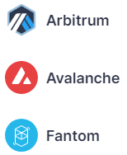

AAVE
One of the largest lending protocols:
First deployed on Ethereum blockchain in November 2020
Now deployed on seven networks, with 13 different markets
~$7.7 billion USD worth of assets locked across all markets (March 2023)
Over 50 cryptocurrencies allowed for usage on main Ethereum market

Slide 17
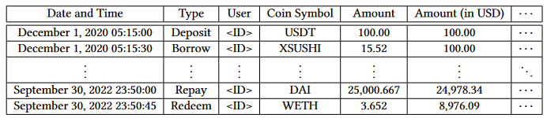
Transaction-Level Data
All 1,665,737 basic transactions since AAVE launched (November 30, 2020 - February 3, 2023)
Data acquired from TheGraph.com, where AAVE developers manage subgraphs for various deployments

Slide 18
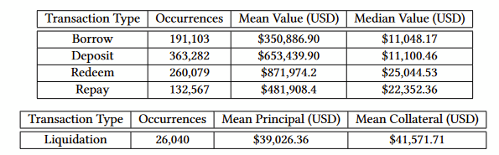
Transaction-Level Data
All 1,665,737 basic transactions since AAVE launched (November 30, 2020 - February 3, 2023)
Data acquired from TheGraph.com, where AAVE developers manage subgraphs for various deployments

Slide 19
Iterative Conversion from Transactions to Survival Data
Choose desired index and outcome events (e.g., borrows as index events and repays as outcome events)

Slide 20
Iterative Conversion from Transactions to Survival Data
Choose desired index and outcome events (e.g., borrows as index events and repays as outcome events)
For each borrow (index event), iterate through repays (outcomes) until you find a repayment by the same user of the same coin

Slide 21
Iterative Conversion from Transactions to Survival Data
Choose desired index and outcome events (e.g., borrows as index events and repays as outcome events)
For each borrow (index event), iterate through repays (outcomes) until you find a repayment by the same user of the same coin
Subtract time of repay from time of borrow, or final time from time of borrow if censored

Slide 22
Iterative Conversion from Transactions to Survival Data
Choose desired index and outcome events (e.g., borrows as index events and repays as outcome events)
For each borrow (index event), iterate through repays (outcomes) until you find a repayment by the same user of the same coin
Subtract time of repay from time of borrow, or final time from time of borrow if censored
Pros:
Simple logic

Slide 23
Iterative Conversion from Transactions to Survival Data
Choose desired index and outcome events (e.g., borrows as index events and repays as outcome events)
For each borrow (index event), iterate through repays (outcomes) until you find a repayment by the same user of the same coin
Subtract time of repay from time of borrow, or final time from time of borrow if censored
Pros:
Simple logic
Cons:

Slide 24
Iterative Conversion from Transactions to Survival Data
Choose desired index and outcome events (e.g., borrows as index events and repays as outcome events)
For each borrow (index event), iterate through repays (outcomes) until you find a repayment by the same user of the same coin
Subtract time of repay from time of borrow, or final time from time of borrow if censored
Pros:
Simple logic
Cons:
Pitifully slow

Slide 25
Iterative Conversion from Transactions to Survival Data
Choose desired index and outcome events (e.g., borrows as index events and repays as outcome events)
For each borrow (index event), iterate through repays (outcomes) until you find a repayment by the same user of the same coin
Subtract time of repay from time of borrow, or final time from time of borrow if censored
Pros:
Simple logic
Cons:
Pitifully slow
Loops make John Erickson mad

Slide 26
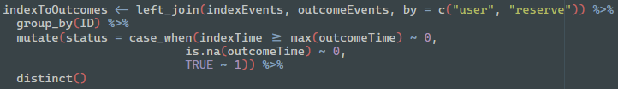
Speeding things up with ‘dplyr’

Slide 27
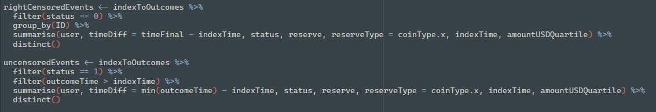
Speeding things up with ‘dplyr’

Slide 28
Speeding things up with ‘dplyr’
Very space intensive

Slide 29
Speeding things up with ‘dplyr’
Very space intensive
Faster, but still not fast

Slide 30
Mass-Produced Results:
Wanted to make an app that has survival data for all possible index and outcome events:
Basic events:
Borrow;
Repay;
Deposit;
Redeem;
Liquidation (liquidation performed, account liquidated)
Other calculated outcomes:
Full Repay;
Full Redeem;
Aggregated Liquidations

Slide 31
Generalized Function to Create Survival Data
Parameters:
data frame
set of index events (e.g., borrow)
set of outcome events (e.g., liquidation, repay)

Slide 32
Generalized Function to Create Survival Data
Parameters:
data frame
set of index events (e.g., borrow)
set of outcome events (e.g., liquidation, repay)
list of subjects (e.g., user and reserve, or just user)
observation window

Slide 33
Generalized Function to Create Survival Data
Parameters:
data frame
set of index events (e.g., borrow)
set of outcome events (e.g., liquidation, repay)
list of subjects (e.g., user and reserve, or just user)
observation window
index event covariates (e.g., coin type, USD amount quartile, etc.)
outcome event covariates (e.g., principal coin type, collateral coin type)

Slide 34

Some Results, Finally

Slide 35
Real-Data Results
Each transaction is a candidate for index and outcome events:
E.g., how long do users wait to make a repayment after borrowing funds?

Slide 36
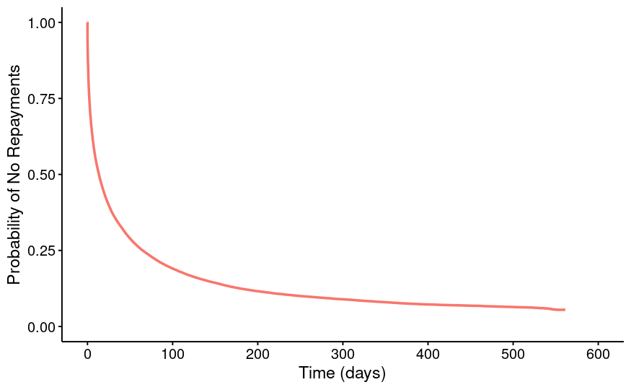
Real-Data Results
Each transaction is a candidate for index and outcome events:
E.g., how long do users wait to make a repayment after borrowing funds?
Index event: borrow transactions
Outcome event: repay transactions

Slide 37
Effect of Coin Type on Loan Outcomes
What are the differences in loan outcome timings (repayments, liquidations) for stable coins versus non-stable coins?

Slide 38
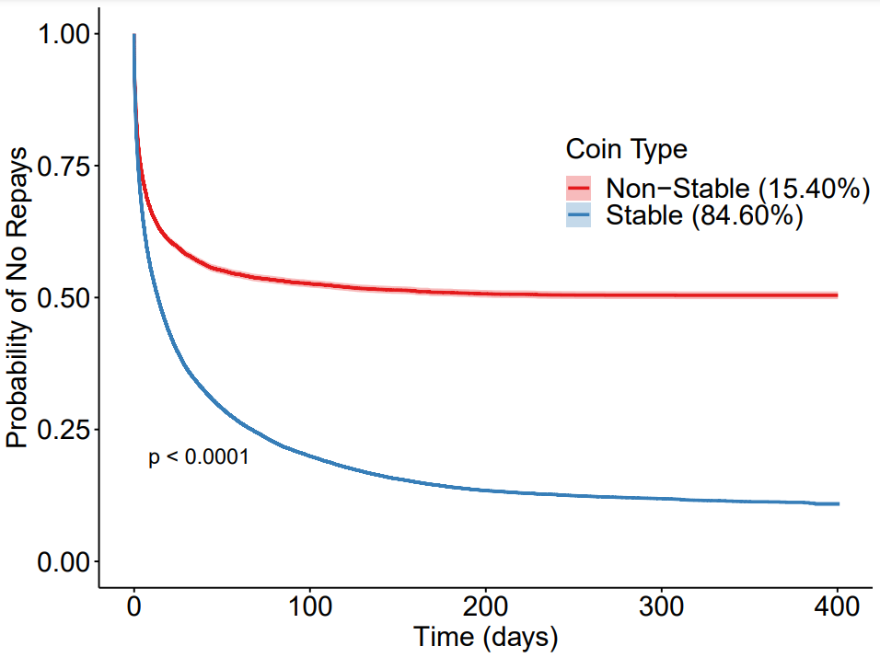
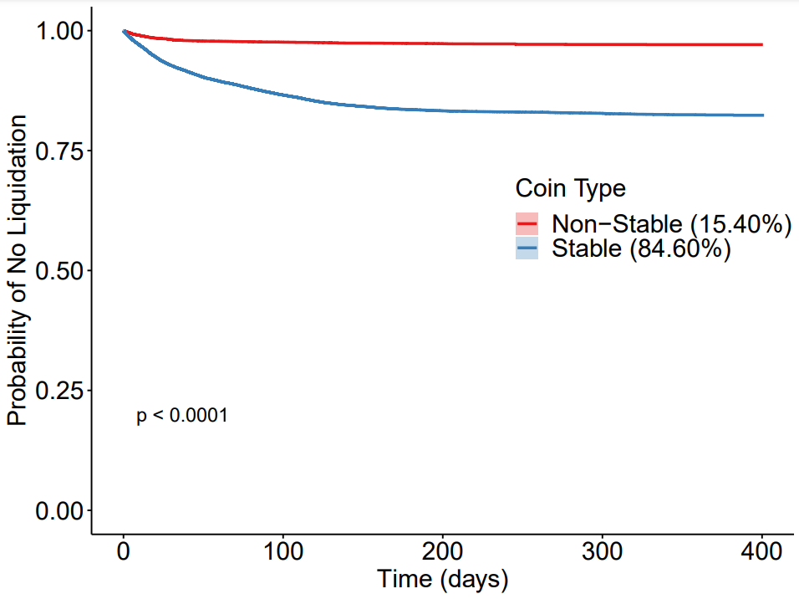
Effect of Coin Type on Loan Outcomes
Outcome event: repayment
Outcome event: liquidation

Slide 39
Principal:Collateral Combinations and Liquidations
More than just single repays can be used as outcomes for borrow events:
Liquidation
Repay in full
Redeem (withdrawal)

Slide 40
Principal:Collateral Combinations and Liquidations
More than just single repays can be used as outcomes for borrow events:
Liquidation
Repay in full
Redeem (withdrawal)
Variety of categories for comparison:
Cryptocurrency borrowed
Type of coin (stable or non-stable)
Amount borrowed

Slide 41
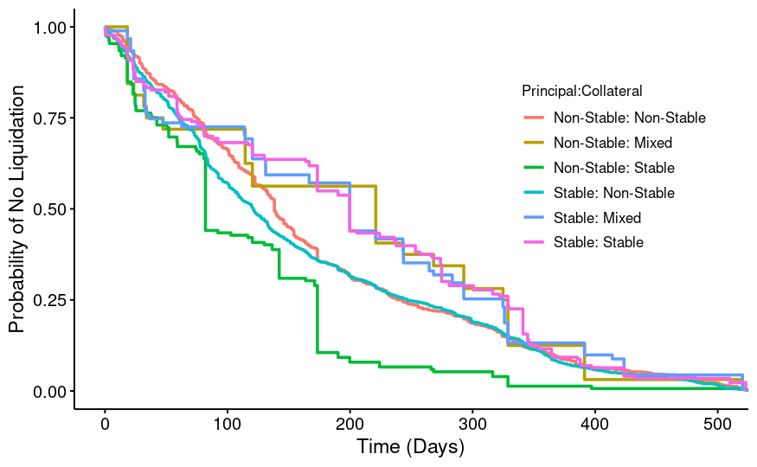
Principal:Collateral Combinations and Liquidations
More than just single repays can be used as outcomes for borrow events:
Liquidation
Repay in full
Redeem (withdrawal)
Outcome event: loan liquidation
Category: Principal-Collateral combination
Variety of categories for comparison:
Cryptocurrency borrowed
Type of coin (stable or non-stable)
Amount borrowed

Slide 42
Understanding Effects of Loan Size
How does loan size affect repayment schedules?

Slide 43
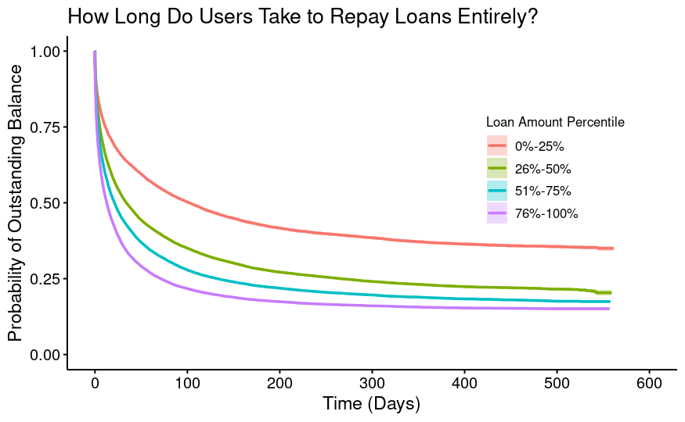
Understanding Effects of Loan Size

Slide 44
Understanding Effects of Loan Size
Larger loans get repaid more quickly!

Slide 45
Understanding Effects of Loan Size
How does riskiness vary with loan size?
Larger loans get repaid more quickly!

Slide 46
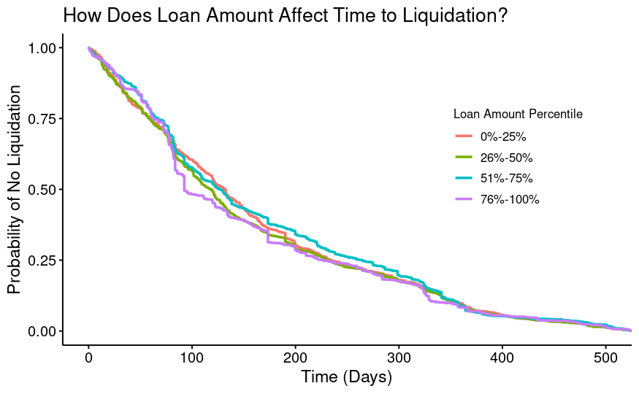
Understanding Effects of Loan Size
Larger loans get repaid more quickly!
Loan size has little to no effect on riskiness!

Slide 47
Changing Observation Windows
Another way to segment survival curves is by time-frame of index or outcome events:
E.g. how have repayment timelines differed between quarters from 2021 Q1 to 2022 Q3?

Slide 48
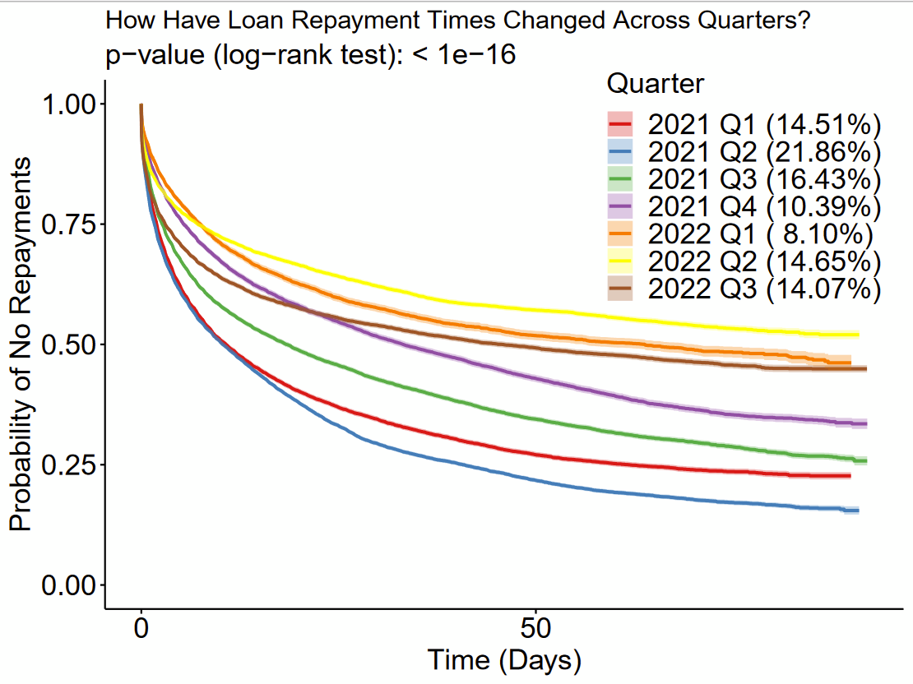
Changing Observation Windows
Another way to segment survival curves is by time-frame of index or outcome events:
E.g. how have repayment timelines differed between quarters from 2021 Q1 to 2022 Q3?

Slide 49
Time to expand to other deployments:

Slide 50
Time to expand to other deployments:
3% of all transactions

Slide 51
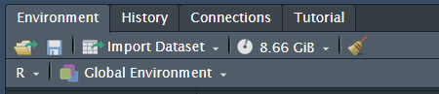
The Wall

Slide 52
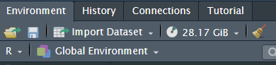
The Wall

Slide 53
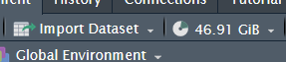
The Wall

Slide 54

The Wall

Slide 55
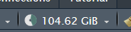
The Wall

Slide 56
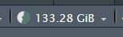
The Wall

Slide 57
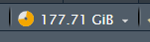
The Wall

Slide 58
The Wall

Slide 59
The Wall

Slide 60
The Wall

Slide 61
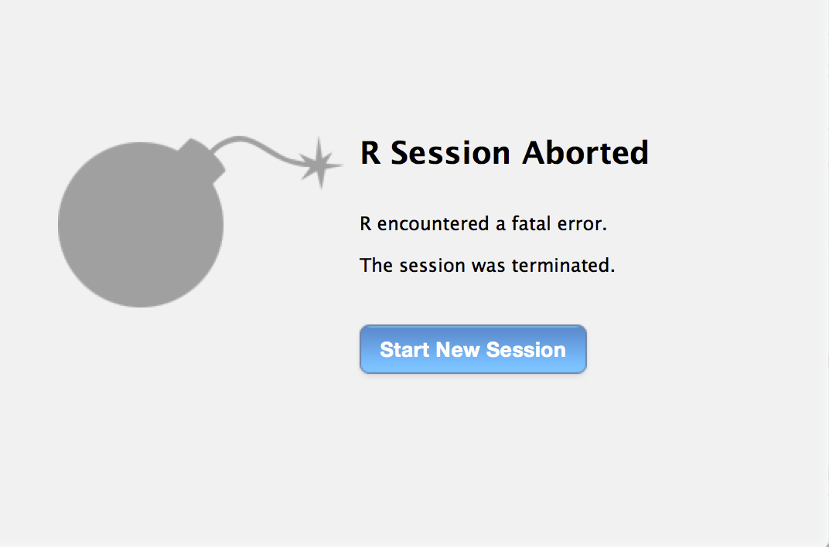

The Wall

Slide 62
Attempted Fixes
Filtering joins?
Not implemented in ‘dplyr’
Tried SQL package with filtering joins, but didn’t save enough space

Slide 63
Attempted Fixes
Filtering joins?
Not implemented in ‘dplyr’
Tried SQL package with filtering joins, but didn’t save enough space
Split into groups?
One deployment at a time
Do 1/10th of the users at a time

Slide 64
Attempted Fixes
Filtering joins?
Not implemented in ‘dplyr’
Tried SQL package with filtering joins, but didn’t save enough space
Split into groups?
One deployment at a time
Do 1/10th of one deployment at a time

Slide 65
Attempted Fixes
Filtering joins?
Not implemented in ‘dplyr’
Tried SQL package with filtering joins, but didn’t save enough space
Split into groups?
One deployment at a time
Do 1/10th of one deployment at a time
One user at a time?

Slide 66
The Wall

Slide 67
Desperation Google Searches eventually yield…
This link!!!

Slide 68
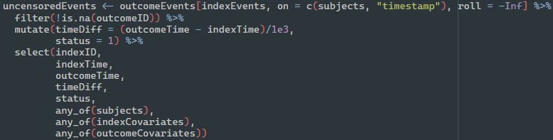
Implementing Rolling Join

Slide 69
Implementing Rolling Join
Compute uncensored events directly, with no group_by()

Slide 70
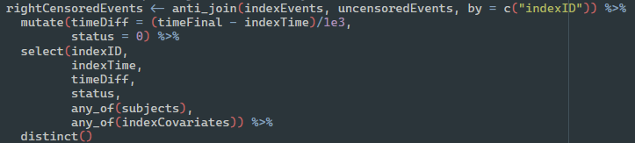
Implementing Rolling Join
Compute uncensored events directly, with no group_by()

Slide 71
Implementing Rolling Join
Compute uncensored events directly, with no group_by()
Again, no group_by()

Slide 72
App Demo

Slide 73
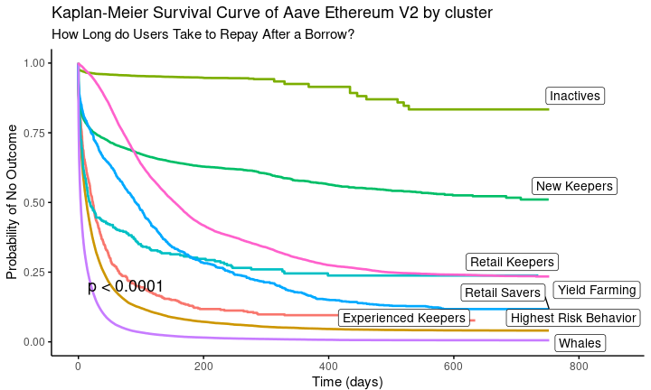
Hot Off the Press!
Users are clustered by their behavior on a quarter-by-quarter basis
Clusters can be used as covariate

